Slide 1
Operating Systems
Books:
Operating System Concepts
By: A. Silberschatz
P. B. Galvin
Modern Operating System
By: A. S. Tanenbaum
Distributed Operating System
By: P.K. Sinha

Slide 2
Objectives
To provide insight about the working of computer system
To provide a tour of the major operating systems components
To enable students to understand, evaluate and explore various operating systems

Slide 3

Computer System Organization
Computer-system operation
  One or more CPUs, device controllers connected through common bus (Address, Data, Control) providing access to all components
  Concurrent execution of CPUs and devices will be competing for memory cycles

Slide 4
Computer System Structure
Computer system consists of these components
  Hardware – provides basic physical computing resources
    CPU, memory, I/O devices
  Software
    Operating system
      Controls and coordinates usage of hardware among various applications and users
    Application programs – define the ways in which the system resources are used to solve any computing problem of the users
      Word processors, compilers, web browsers, database systems, video games
  Users
    People, Real Time Process Managements, machines / other computers

Slide 5

Components of a Computer System

Slide 6

What is an Operating System?
An important part of almost every computer system, that provides user interface and acts as a manager
A program that acts as an intermediary between a user and computer hardware.
An environment to execute programs.
A Resource Manager
A managing program running all the times
Operating System
Hardware

Slide 7
Terms used
Program:- A logical sequence of instructions to achieve any goal (to calculate /control /manage any thing)
Computational Resource :-
  Any thing used in execution of a program
  That costs
Types of Computational Resources
  Hardware (CPU, Time, Storage, I/O Devices, etc.)
  Software (Libraries, Drivers, systems/packages ,etc.)
  Virtual (Resources that exist logically through software)

Slide 8
What is an Operating System?
Goals of an operating system:-
  Execute user programs and make problem solving easier.
  Make the computer system convenient to use.
  Use the hardware in an efficient manner.
  Preventing improper usage of resources, and avoid in-consistency
  Reporting and correction of errors

Slide 9
Operating System Definition (Cont.)
No universally accepted definition of OS
“Everything a vendor ships when you order an operating system” is a good approximation
  But varies widely
“The one program running at all the times on the computer” is the kernel. Everything else is either a system program (shipped with the operating system) or an application program

Slide 10
More Definitions
OS is a User Interface
  intermediary between a user and computer
OS is a resource allocater / reclaimer
  Manages and optimizes usage of all resources
    Physical resources
    Virtual resources
  Decides between conflicting requests for efficient and fair resource usage
OS is a control program
  Controls execution of programs to prevent errors and improper usage of the computer

Slide 11
Operating System as Manager
What Operating Systems Manages: All resources.
  Process / Time Management
  Memory Management
  Storage Management
  Input/Output Management
  Exclusive Resource usage and Deadlock avoidance
  Protection and Security
  Special-Purpose Systems
  Computing Environments

Slide 12
Protection and Security
Protection – any mechanism for controlling access of processes or users to resources as defined by the OS
Security – defense of the system against internal and external attacks
  Huge range; including denial-of-service, worms, viruses, identity theft, theft of info and services
Systems generally first distinguish among users, to determine who can do what
  User identities (user IDs, security IDs) include name and associated number, one per user
  User ID then associated with all files, processes of that user to determine access control
  Group identifier (group ID) allows set of users to be defined and controls managed, then also associated with each process, file
  Privilege escalation allows user to change to effective ID with more rights

Slide 13
Operating-System, operations and security
Hardware Interrupt is generated by hardware on any event / error
Software exception or trap is generated by error or request from within a program
  E.g. Division by zero, request for operating system service
  Other process problems include infinite loop, Memory protection (processes modifying each other or operating system area)
Dual-mode of operation allows OS to protect itself and other system components
  User mode and kernel mode
  Mode bit is provided by hardware
    Provides ability to distinguish when system is running a user code or kernel code
    Some instructions designated as privileged ones are executable only in kernel mode
    System call changes mode to kernel, return from call resets it to user mode

Slide 14

Transition between User and Kernel Mode
To differentiate OS activity from any user’s activity
Timer to prevent infinite loop / process hogging resources
  Set interrupt after specific period
  Operating system decrements counter
  When counter zero, generate an interrupt
  Set up before scheduling process to regain control or terminate program that exceeds allocated time

Slide 15
Program Generation and Execution
Editing in certain programming Language
Compilation (converting high level code to executable code)
    Usually a re-locatable code (starting from zero address)
Linking Making a single (executable) module from object codes (main module and other sub procedures) e.g. making an EXE file, which is stored on disk.
Types of generated codes
  Absolute code (loadable only at some specific address for execution)
  Re-locatable code (loadable at any available address in memory)
  Re-entrant code (Pure code; Instructions only no data dependency)
Loading and Relocation
  Compile time Relocation (address binding at compilation time)
  Static Relocation
    Address binding at loading time (same logical and physical addresses)
  Dynamic relocation at execution time (needs H/W support)
    Address binding at run time (different logical and physical addresses)

Slide 16
Linking object modules, to make a single executable code
Main.obj
0 …….
4 …….
8 jsr abc
12 ……
……..
……..
96 exit
Main.exe
0 …….
…….
8 jsr 100
12 ……
……..
……..
96 exit
100 mov #20, R1
104 …….
108 jsr 140
112 ……
……..
136 ret
140 …….
144 jmp 160
152 ……
……..
160 clr R2
……
……
mov R1, @ 140
abc.obj
0 mov #20, R1
4 …….
8 jsr xyz
12 ……
……..
36 ret
xyz.obj
0 …….
4 jmp 20
12 ……
……..
20 clr R2
……
……
100 mov R1, @ 0
Linker makes a single module and re-adjusts the relative addresses

Slide 17

Relocation
Static or load-time relocation
  The loader handles relocation while loading any re-locatable program, at any available memory location L, for each logical re-locatable address ‘r’.
  Thereby, the physical or final address ‘F’ after loading will be changed as (in EXE file, the info about re-locatable entries is in exe-header)
      F = L + r (same logical and physical address in loaded program)
Dynamic or run-time relocation
  Needs relocation register (hardware), to store base address L (14000) to compute final physical address F (14346) during execution for any CPU generated logical address r (346)
  logical address remains same as generated by compiler, so the logical address of loaded program is different from the physical address at the time of execution

Slide 18
Process and its Management
A process is a program in execution. It is a unit of work within the system. Program is a passive entity, process is an active entity.
Process needs resources which are allocated at beginning or during execution, to accomplish its task
    CPU, memory, I/O, files
    Initialization data
Process termination requires reclaiming of all reusable resources
Each process has one program counter specifying the location of next instruction to be executed (Processor executes instructions sequentially, one at a time, until completion)
Multi-stream (multi threaded) process has one program counter per thread
Typically system has many processes, some user’s, some operating system modules, running concurrently on one or more CPUs
  During sharing of resources, Mutual exclusion, Concurrency and Synchronization issues arise by multiplexing the CPUs among processes / threads

Slide 19
Process Management Activities
The operating system is responsible for the following activities in connection with process management:
Creating and deleting both user and system processes
Suspending and resuming processes
Providing mechanisms for process synchronization
Providing mechanisms for process communication
Providing mechanisms for deadlock handling

Slide 20
Computer Startup
bootstrap program: At power-up or reboot, the CPU jumps to a certain Specific address, pointed by CS:IP register. (FFFF0000) into bootstrap program which is loaded at this address.
  Typically it is stored in ROM or EPROM, which does not erase when switched off and generally known as firmware
  Initializes all necessary components of the system
  Loads operating system kernel and starts execution
  IBM PC boots in two steps
    through BIOS: Basic I/O System
    MBR: Master Boot Record on hard disk, which loads OS Kernel in RAM and transfers control to the kernel

Slide 21
I/O Subsystem
One purpose of OS is to hide complexities and peculiarities of hardware devices from the user
I/O subsystem responsible for
  Memory management of I/O including buffering (storing data temporarily while it is being transferred), caching (storing parts of data in faster storage for performance), spooling (the overlapping of output of one job with input of other jobs)
  General device-driver interface
  Drivers for specific hardware devices

Slide 22
I/O Contd.
I/O is much slower than CPU operations
I/O devices can perform I/O concurrently.
I/O devices and CPU can execute concurrently.
CPU interacts with I/O devices through device controllers.
Independent I/O handling, relieves CPU for other processing
Mostly a dedicated and most generalized software program (Driver) is associated with I/O devices
CPU
Controller
Device

Slide 23
Input Output
I/O controllers (Interfaces) for any device
  Each device controller is responsible for a device
  Each device controller has a local buffer.
  Transfers data between local buffer on controller and device
  Coordinates with CPU to Transfers data between local buffer on controller to CPU or memory
Types of I/O
  CPU driven
    Polling (busy waiting is done by the CPU, to poll until device becomes ready)
    Interrupt based (controller takes partial responsibility- controller interrupts CPU when device is ready or generates an event)
  Controller Driven (DMA: Direct Memory Access, for block devices- controller takes major responsibility)
    CPU initiates DMA (loads Address, I/O Type, Size)
    Device controller informs CPU that it has finished transfer operation (directly between RAM and Device) by causing an interrupt.

Slide 24
Interrupts, Traps, Exceptions, Signals
(To get Immediate/early attention of processor)
Needs Interrupt enabled architecture i.e. after saving the address of the current stream of instructions onto stack, transfers control to the relevant interrupt service routine (ISR), after which CPU returns to the interrupted current process, by re-loading its IP from the stack.
Interrupt Table contains the addresses of all the Interrupt service routines, used for different interrupts.
Same type of Incoming interrupts are mostly disabled (to avoid reentrant code for ISR), while other interrupts can be nested and processed in an interleaved fashion.
Interrupt controllers are used to handle priority, and saving concurrent interrupts to prevent loss of interrupts

Slide 25
Interrupts-Exceptions-Traps-Signals
These are also used to handle/inform un-usual conditions
Interrupts: Mechanism to provide a way to divert processor to attend some other important activity (execute code) out side normal flow of execution. E.g. I/O interrupt, condition interrupt, Non maskable interrupt (NMI), etc.
  NMI: Interrupt that can not be masked (disabled) e.g. power fail
Exceptions: faults or anomalous conditions during execution. E.g. programming error, division by zero, overflow, page faults, etc.
Traps: software interrupts for system calls (e.g. int 0x21 for PC DOS) and debugging (int 3)
Signals: very short message to be sent to an other process to inform about an event and to execute signal handler. E.g. sigkill, sigtrap, siguser1, etc.

Slide 26
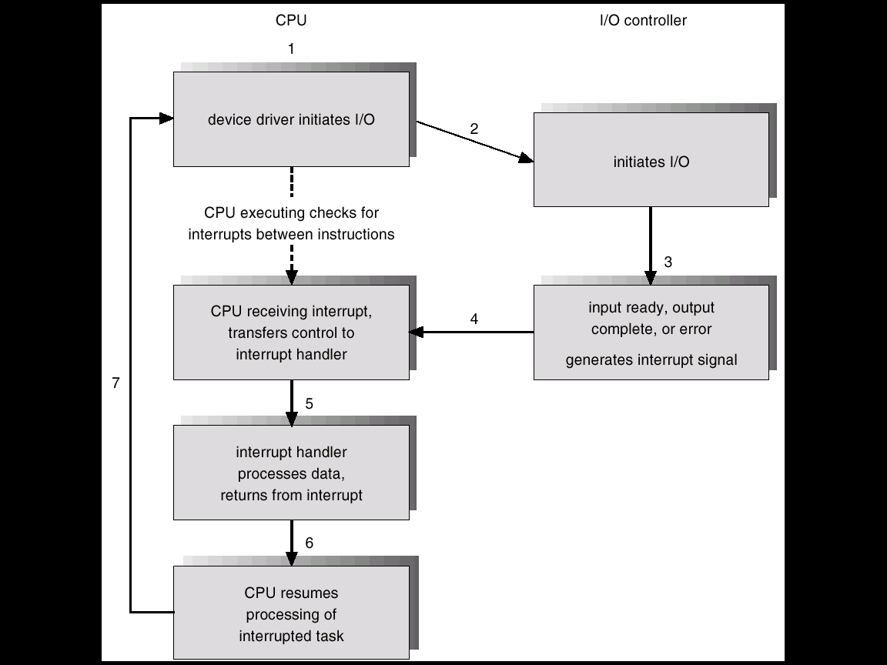
Interrupt-Driven I/O Cycle

Slide 27
Interrupts, Traps, Exceptions (cont)
Trap
A trap is a software-generated interrupt on request (e.g. int 0x80 for system calls on some Unix like operating systems).
Exceptions
An interrupt caused by some error e.g. division by zero, overflow, invalid op-code, etc.
Signals
No explicit hardware triggering support, however, improvised by OS, checked on return from interrupt, for handling pending signals

Slide 28
Interrupt Handling
After completing current instruction determines which type of interrupt has occurred and handles using
  Multiple lines, separate interrupt e.g. Non-maskable Interrupt (NMI), and general Interrupt line (INT)
  Single line multiple interrupts (How to Identify?)
    polling system (CPU checks each device)
    vectored interrupt system (device writes ID on data bus)
The operating system looks for relevant (ISR) that preserves the state of the CPU by storing registers onto stack and restores them on return.
Separate segments of code (ISRs) determine what action should be taken for each type of interrupt

Slide 29

Interrupt Timeline
When any I/O is in progress the CPU can continue execution of any process, shown by first blue line. When I/O is completed, the device raises interrupt on transfer done, After completion of current instruction OS notices interrupt, determines its ISR and transfer control to its ISR. The ISR after completions redirects the CPU to interrupted program.
User’s process executing
ISR executing

Slide 30
Direct Memory Access (DMA) Structure
Used for high-speed Block I/O devices, able to transmit buffered information, at nearly memory speeds,
CPU only initiates DMA transfer on controller, by loading various registers e.g. address, type and size (count) of I/O, of DMA device controller.
Device controller transfers blocks of data from controller’s buffer directly to main memory, piece wise, by cycle stealing. Slowest, but without CPU intervention
Bus Arbitration logic (bus-req, bus-busy, bus-granted, etc.) is needed on the system, supporting DMA, for sharing of the external bus.
Controller takes over the role of CPU to use external bus when bus is granted. After one word/byte transfer it decrements the count accordingly and frees the bus.
Only one interrupt is generated (on count=0) per block transfer, rather than one interrupt per byte/word.

Slide 31

Six Steps to Perform DMA Transfer
(using Cycle stealing on systems with bus arbitration logic implemented)
The CPU loads disk address D, target address X in RAM, size of transfer C and type of I/O in DMA device controller. The controller transfers data piece wise, and raises interrupt signal on completion.

Slide 32
I/O Structure
QIOW:- After I/O starts, control returns to user program only upon I/O completion. (Synchronous I/O)
  Wait instruction idles the process until the next interrupt
  Wait loop (contention for memory access).
  At most one I/O request is outstanding at a time, no simultaneous I/O processing.
QIO:- After an I/O starts, control returns to user program, which continues without waiting, may wait at suitable location for I/O completion. (Asynchronous)
  System call is needed to request the operating system to allow user to wait for I/O completion, indicated by an event.
  Device-status table contains entry for each I/O device indicating its type, address, and state.
  Operating system indexes into I/O device table to determine device status and to modify table entry to include interrupt.

Slide 33

Device-Status Table

Slide 34
Synchronous-Asynchronous- Isochronous
Synchronous
  The requesting processes wait until I/O is complete
Asynchronous
  The requesting processes do not wait for I/O to be completed, they continue execution
  The I/O completion is notified trough some mechanism e.g. event flags in QIOs, for which process may wait at some stage.
Isochronous
  data must be delivered within certain time constraints
  Related to multimedia I/O streams.

Slide 35

Synchronous /Asynchronous I/O
Synchronous
(Handshaking)
Asynchronous
(No Handshaking)
(a) Process waits for I/O completion (b) Process continues, does not wait for I/O completion, but later

Slide 36
Synchronous-Asynchronous-Isochronous
Isochronous:- Time-dependent. Pronounced as eye-sock-ra-nuss, it refers to processes where data must be delivered within certain time constraints. For example, multimedia streams require an isochronous transport mechanism to ensure that data is delivered as fast as it is displayed and to ensure that the audio is synchronized with the video.
Isochronous can be contrasted with asynchronous, which refers to processes in which data streams can be broken by random intervals, and synchronous processes, in which data streams can be delivered only at specific intervals.
Isochronous service is not as rigid as synchronous service, but not as lenient as asynchronous service.
Certain types of networks, such as ATM, are said to be isochronous because they can guarantee a specified throughput. Likewise, new bus architectures, such as IEEE 1394, support isochronous delivery.

Slide 37
Memory and other storage Devices
Types of storage devices
  Primary (Directly accessible to CPU)
    Normally called Random Access Memory (RAM)
    Read Only Memory (ROM)
    Erasable ROM (EPROM)
  Secondary (Not directly accessible to CPU)
    Usually Magnetic Storage Devices (Disk, tape, drums, etc.)
    USB storage devices
  Tertiary (Not directly accessible to CPU)
    Paper tapes
    Punch cards

Slide 38
Storage Structure
Main memory – only large storage media that the CPU can access directly.
Secondary storage – extension of main memory that provides large nonvolatile storage capacity.
  Magnetic disks – rigid metal or glass platters covered with magnetic recording material
  Disk surface is logically divided into tracks, which are subdivided into sectors.
  The disk controller determines the logical interaction between the device and the computer.

Slide 39
Primary Memory Management
All instructions and needed data shall be in primary memory (RAM/ROM) in order to execute
Loader: To load program in RAM, first component of OS
Memory management determines what is loaded in memory when
  Optimizing CPU utilization and computer response to users
Memory management activities
  Keeping track of which parts of memory are currently being used and by whom
  Keeping track of free memory slots
  Deciding which processes (or parts thereof) and data to move into and out of memory
  Allocating and deallocating memory space as needed

Slide 40
Storage Hierarchy
Storage systems are organized in hierarchy, depending upon:
    Speed
    Access time
    Cost
    Size
    Volatility (retention)
Caching – copying information into faster storage system; main memory can be viewed as a last cache for secondary storage.

Slide 41
Disk Storage Management
OS provides uniform, logical view of information storage
  Abstracts physical properties to logical storage unit - file
  Each medium is controlled by device (i.e., disk drive, tape drive)
    Varying properties include access speed, capacity, data-transfer rate, access method (sequential or random)
File-System management
  Files are usually organized into directories
  Access control on most systems to determine who can access what
  OS activities include
    Creating and deleting files and directories
    Primitives to manipulate files and dirs
    Mapping files onto secondary storage
    Backup files onto stable (non-volatile) storage media
    Storage de-fragmentation

Slide 42
Mass-Storage Management
Usually disks are used to store data that does not fit in main memory or data that must be kept for a “long” period of time.
Proper management is of central importance
Entire speed of computer operation hinges on disk subsystem and its algorithms
OS activities
  Free-space management
  Storage allocation
  Disk scheduling
    Arranging order of various accesses to reduce effective time
Some storage need not be fast
  Tertiary storage includes optical storage, paper tape, cards, etc. Still must be managed
  Varies between WORM (write-once, read-many-times) and RW (read-write)

Slide 43

Storage-Device Hierarchy
Speed (Inc)
Cost (Dec)

Slide 44
Caching
Caching is performed at many levels in a computer (in hardware, operating system, software)
Information in use is copied from slower to faster storage temporarily, to save access time
Faster storage (cache) is checked first to determine if information is available
  If it is (Cache Hit), information is used directly from the cache If not, (Cache Miss) data is accessed from slower location for use and copied to cache
Cache is much smaller than storage being cached
  Cache management, an important design problem
    Cache size
    Replacement policy (retain active, remove inactive entries)
    Cache consistency and coherence

Slide 45

Performance of Various Levels of Storage
Movement between various levels of storage hierarchy can be explicit or implicit

Slide 46

Migration of an integer “A” from Disk to Register for processing
In Multitasking environment, one must be careful to use most recent value, no matter where it is stored in the storage hierarchy
In Multiprocessor environment, must provide cache coherency in hardware such that all CPUs have the most recent value in their cache
In Distributed environment, situation is even more complex
  Several copies of a datum can exist
  Various coherency solutions will be covered later

Slide 47
Enhanced System Usage I
CPU can be scheduled to execute jobs in two ways:
  Non pre-emptive Scheduling: CPU sticks to only one job or process till its completion. Under utilization of CPU and other resources.
  Pre-emptive Scheduling: CPU switches among different processes. Better utilization of CPUand other resources.
Multiprogramming: Needed for efficient utilization of system resources
  Single user / process cannot keep CPU and I/O devices busy at all times to take optimum benefit
  Multiprogramming / Multitasking organizes jobs (code and data) so that CPU has always some job to execute
  A subset of total jobs in system is kept in memory
  One job is selected that runs via job scheduling
  When running job has to wait (for I/O for example), CPU switches to another job under OS’s CPU scheduling policy

Slide 48
Enhanced System Usage II
Timesharing (multitasking) is a logical extension in which CPU switches jobs so frequently that users can interact with each job while it is running, creating interactive computing feeling as if CPU is exclusively attending a job
  Response time usually < 1 second
  Each user has at least one program executing in memory process
  If several jobs are ready to run at the same time  CPU scheduling
  If processes don’t fit in memory, swapping moves them in and out to run
  Virtual memory allows execution of processes not completely loadable in memory, Partially on secondary storage.

Slide 49

Memory Layout for Multiprogrammed System
Address

Slide 50
Computing Environments
Traditional computer
  Blurring over time
  Office environment
    PCs connected to a network, terminals attached to mainframe or minicomputers providing batch and timesharing
    Now portals allowing networked and remote systems access to same resources
  Home networks
    Used to be single system, then modems
    Now firewalled, networked

Slide 51

Computing Environments (Cont.)
Client-Server Computing
  Dumb terminals supplanted by smart PCs (limited view)
  Many systems now servers, responding to requests generated by clients
    Computer-server provides an interface to client to request services (e.g. database)
    File-server provides interface for clients to store and retrieve files

Slide 52
Peer-to-Peer Computing
Another model of distributed system
P2P does not distinguish systems as clients and servers
  Instead all nodes are considered identical peers
  May each act as client, server or both
  Node must join P2P network
    Registers its service with central lookup service on network, or
    Broadcast request for service and respond to requests for service via discovery protocol
  Examples include Napster and Gnutella

Slide 53
Web-Based Computing
Web has become ubiquitous (available every where)
PCs are most prevalent devices
More devices are becoming networked to allow web access
New category of devices to manage web traffic among similar servers: load balancers
Use of operating systems like Windows 95, client-side, have evolved into Linux and Windows XP, which can be clients and servers

